Slide 1

Introduction to Disaster Management
B. Tech (Environmental Studies)

Slide 2
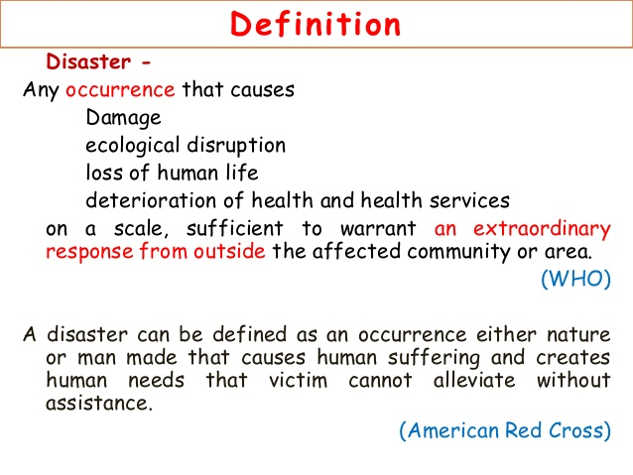

Slide 3
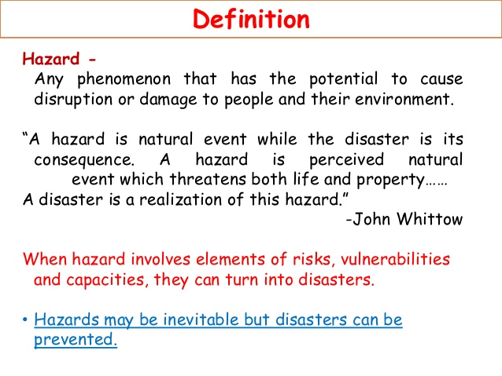

Slide 4
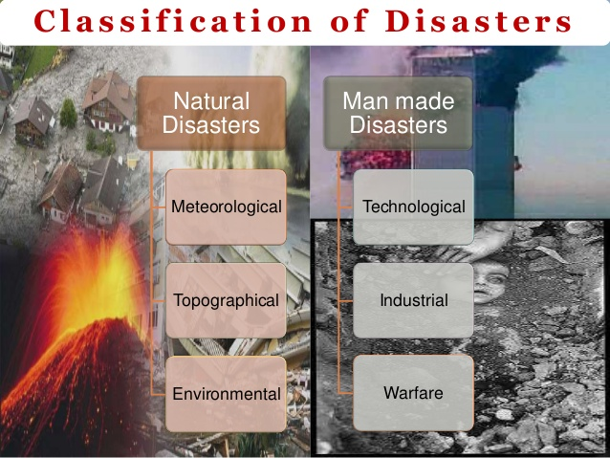

Slide 5
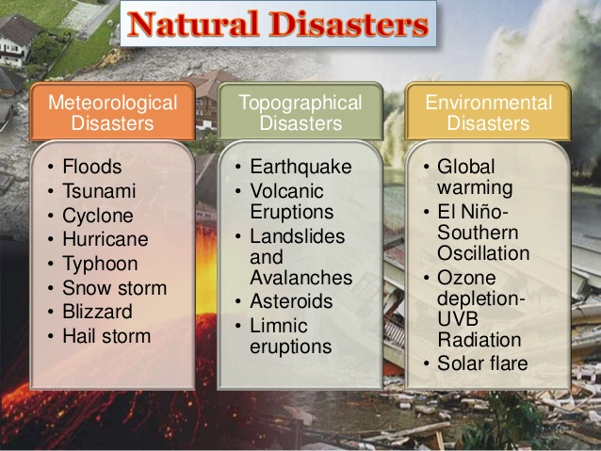

Slide 6
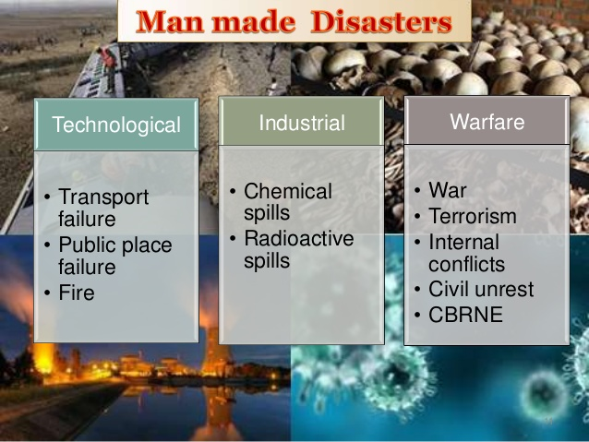

Slide 7
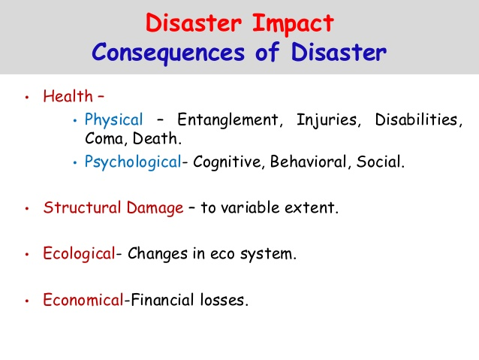

Slide 8
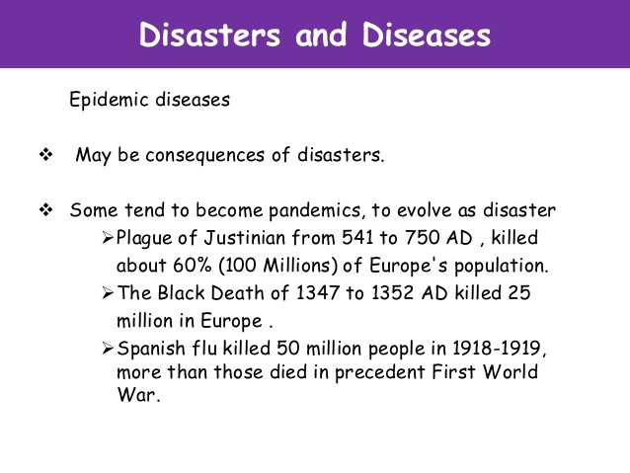

Slide 9
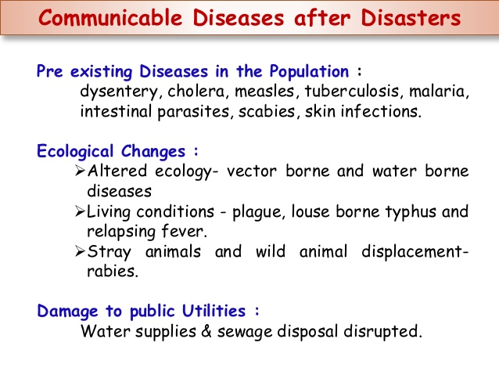

Slide 10
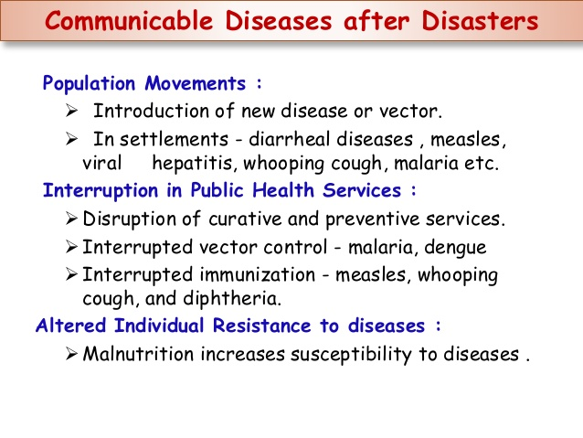

Slide 11
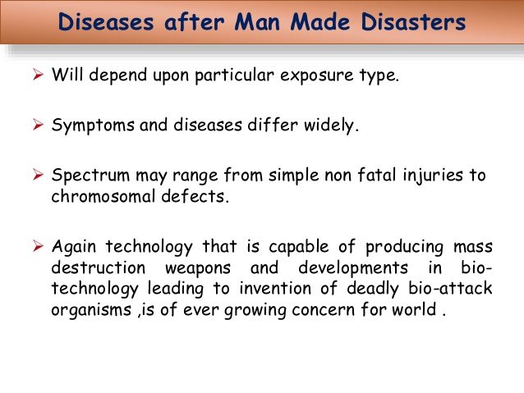

Slide 12
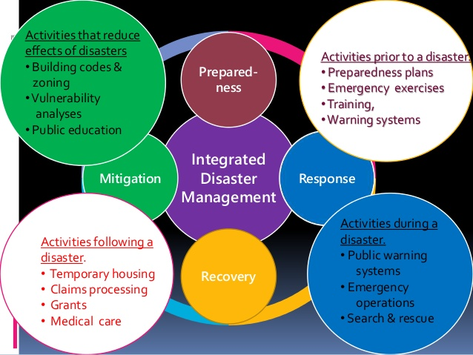
Integrated Disaster Management

Slide 13
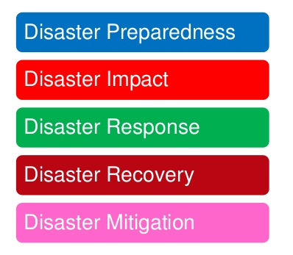
Phases of Disaster Management

Slide 14
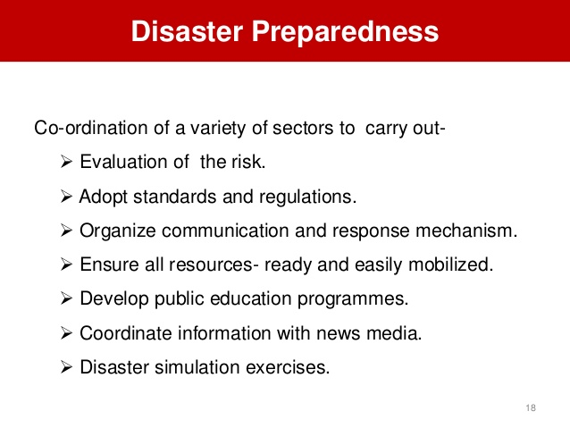
Disaster Preparedness

Slide 15
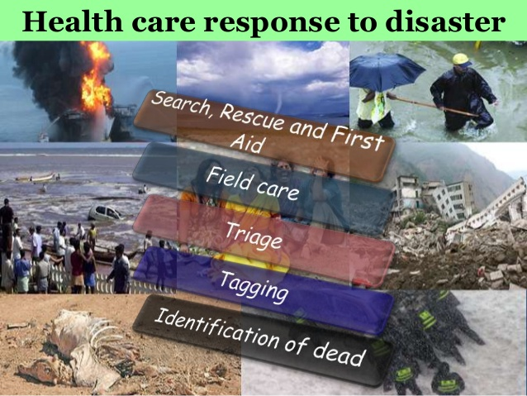

Slide 16
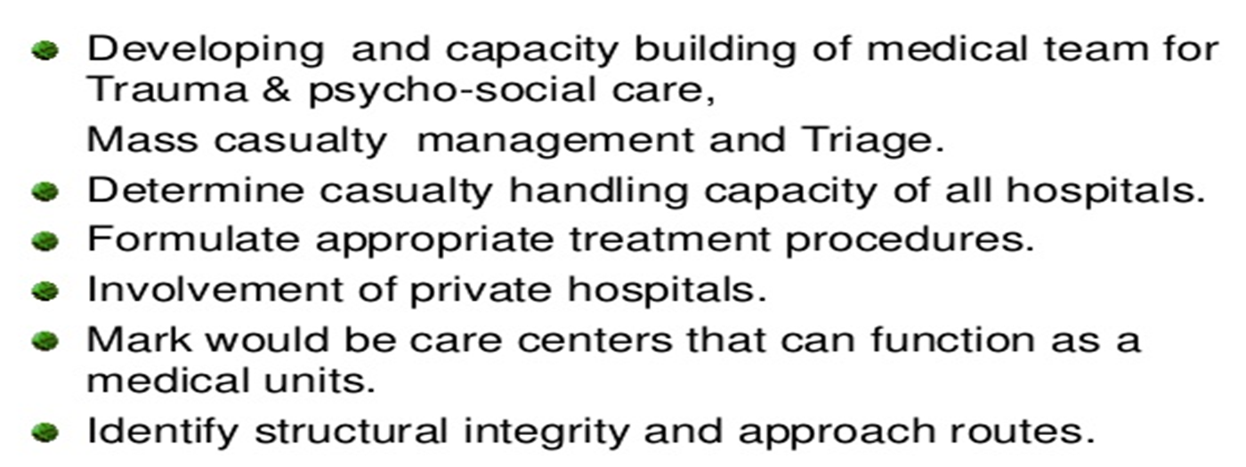
Medical preparedness

Slide 17
Mass casualty and triage
Triage is the process of determining the priority of patients' treatments by the severity of their condition or likelihood of recovery with and without treatment.
A triage tag is a prefabricated label placed on each patient that serves to accomplish several objectives:
identify the patient.
bear record of assessment findings.
identify the priority of the patient's need for medical treatment and transport from the emergency scene.
track the patients' progress through the triage process.
identify additional hazards such as contamination.

Slide 18
In advanced triage, specially trained doctors, nurses and paramedics may decide that some seriously injured people should not receive advanced care because they are unlikely to survive. It is used to divert scarce resources away from patients with little chance of survival in order to increase the chances for others with higher likelihoods.

Slide 19
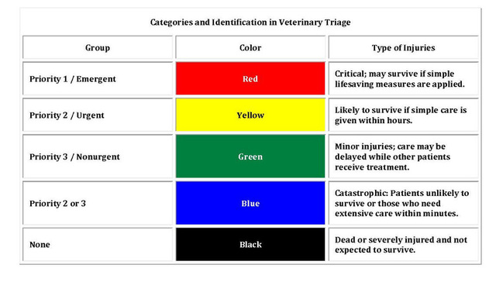

Slide 20
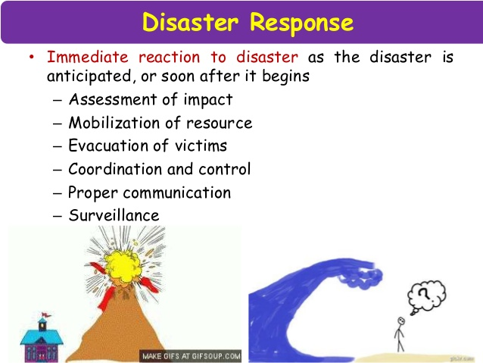

Slide 21
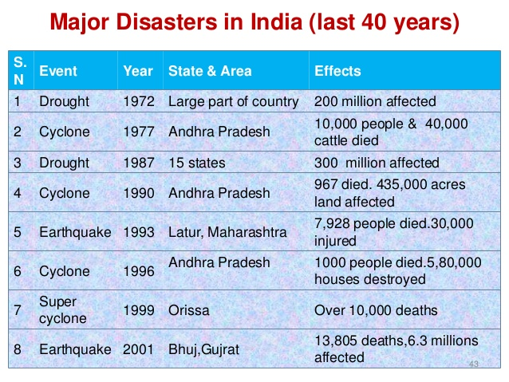
Major disasters in India

Slide 22
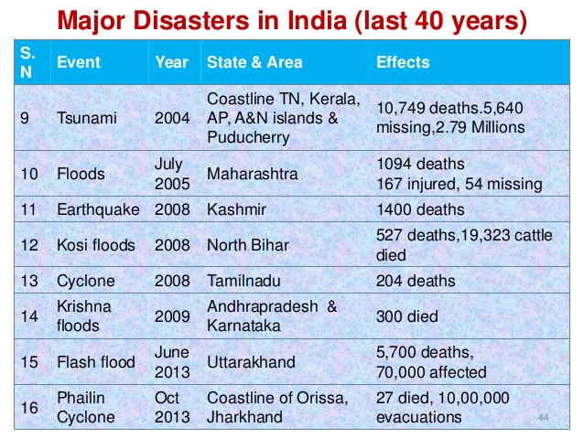
Major disasters in India

Slide 23
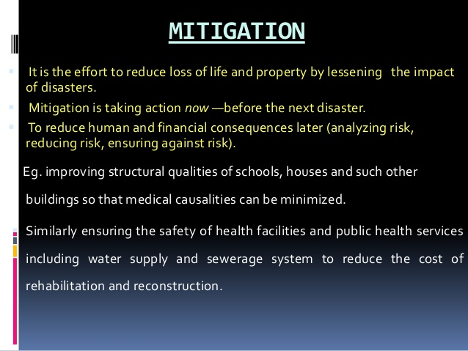
Disaster mitigation

Slide 24
Disaster Management Structures
Indian Metereological Department (IMD) plays a key role in fore warning the disaster of cyclone-storms by detection tracing.
It has 5 centres in Kolkata, Bhubaneswar, Visakhapatnam, Chennai and Mumbai.
In addition there are 31 special detection posts set up along the east-coast of India.

Slide 25
Disaster Management Structures
International agencies which provide humanitarian assistance to the disaster stricken areas are:
United Nation Agencies
World Health Organization
UNICEF
World Food Programm
Food and Agricultural Organization

Slide 26
Disaster Management Structures
Non-government organizations are:
Co-operative for Assistance and Relief Every where (CARE)
International Committee of Red Cross

Slide 27
Other Institutional Arramgements:
Armed forces
Central Paramilitary Forces
State Police Forces and fire Services
Civil Defence and Home Guard
State Disaster Response Forces
Neheru Yuva Kendra Sangathan (NYKS)

Slide 28
Stakeholders’ Participation:
Corporate Social Responsibility
Public Private Pertnership
Media Partenership
Training in communities
DM Education in School

Slide 29
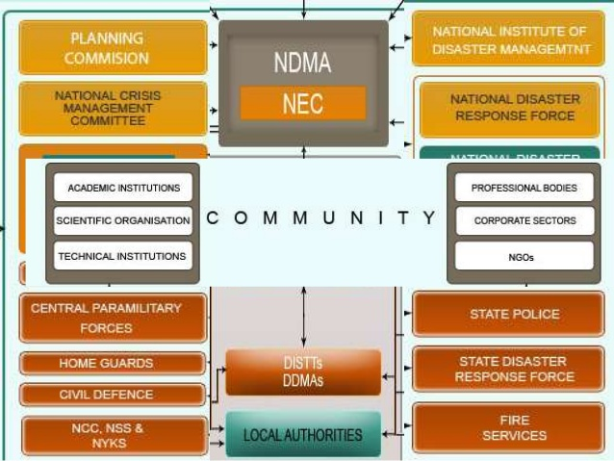

Slide 30
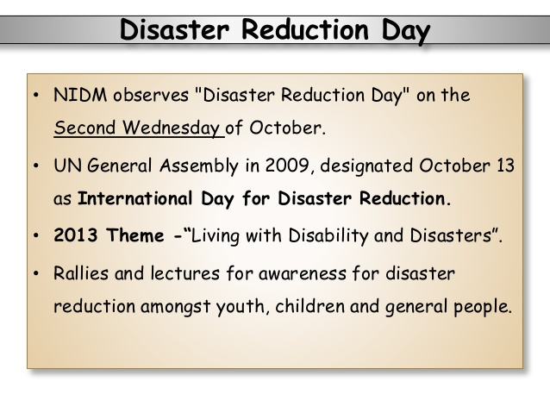

Slide 31
NIDM–National Institute of Disaster Management
NDMA- National disaster Management Authority
DDMA- District Disaster Management authority

Slide 32


